Slide 1


Past Simple vs
Present Perfect

Slide 2
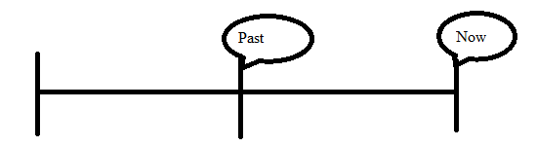
Past Simple
‘Action’ started and ended in the past
Clear indication of time!
E.g. in 1997, yesterday, last week, two days ago.

Slide 3
How to make a Past Simple
verb + ed, e.g. work+ed = worked
Be careful!
Verbs which end in –e only get a -d.
E.g.: love – loved, like - liked
Verbs which end in a consonant (medeklinker) + y get –ied.
Study – studied, hurry – hurried
Irregular verbs: 2nd column of the list

Slide 4


Examples
She worked at the movie theater after school.
The train passed five minutes ago.
He went to Amsterdam yesterday.

Slide 5
Key words
Last night, last week, last month, last year
This morning
At eight o’clock
In 2009
Yesterday
A few years ago

Slide 6
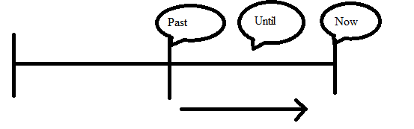
Present Perfect
Started in the past and still going on.
Focussing on result, not on when it happened.
No clear indication of time.

Slide 7
How to make a Present Perfect
I, you, we, they + have + past participle
He, she, it + has + past participle
Past participle is verb + ed
Irregular verbs: 3rd column of the list.

Slide 8
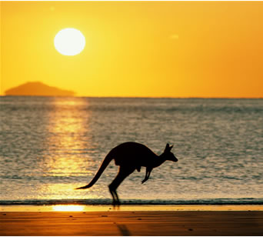
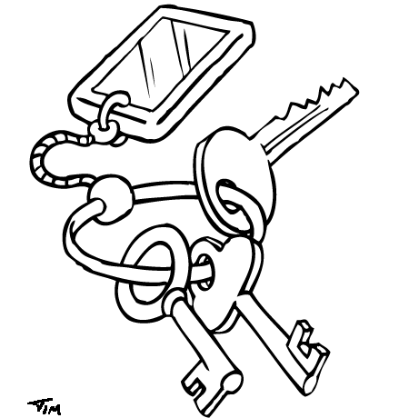
Examples
School has not started yet.
I have never been to Australia.
I have lost my keys.

Slide 9
Keywords
Aan bepaalde woorden kun je ‘zien’ dat je de Present Perfect moet gebruiken. Enkele daarvan zijn samen te vatten in ‘fyne jas’.
Fyne jas = For Yet Never Ever
Just Already (always) Since
Als er helemaal geen tijdsaanduiding in de zin staat is het vaak een Present Perfect!

Slide 10
Schedule
Past Simple Ww + ed | Present Perfect Have of has + voltooid deelwoord
In het verleden begonnen en beëindigd | In het verleden begonnen en gaat nu nog door
I saw three movies last week. | I have seen three movies this week. (de week is nog niet voorbij)
Duidelijke tijdsbepaling | Geen duidelijke tijdsbepaling
He played a match yesterday. (tijdsbepaling → yesterday) | He has played a match. (geen tijdsbepaling → Pres. Perf.)

Slide 11
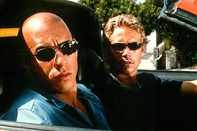
Past Simple vs Present Perfect
The Past Simple is used for completed actions.
I lived in Berkel Enschot for six years. (now I live somewhere else)
Paul Walker made 34 films. (He can’t make any more)
The Present Perfect is used for unfinished actions.
I have lived in Berkel Enschot for 6 years. (I still live there)
Vin Diesel has made 26 films. (he still makes them)

Slide 12
Extra practise
http://www.ego4u.com/en/cram-up/grammar/simpas-preper/exercises?ex05
http://www.ego4u.com/en/cram-up/grammar/simpas-preper/exercises?ex03
http://www.ego4u.com/en/cram-up/grammar/simpas-preper/exercises?ex08
http://www.ego4u.com/en/cram-up/grammar/simpas-preper/tests?test2

